Slide 1


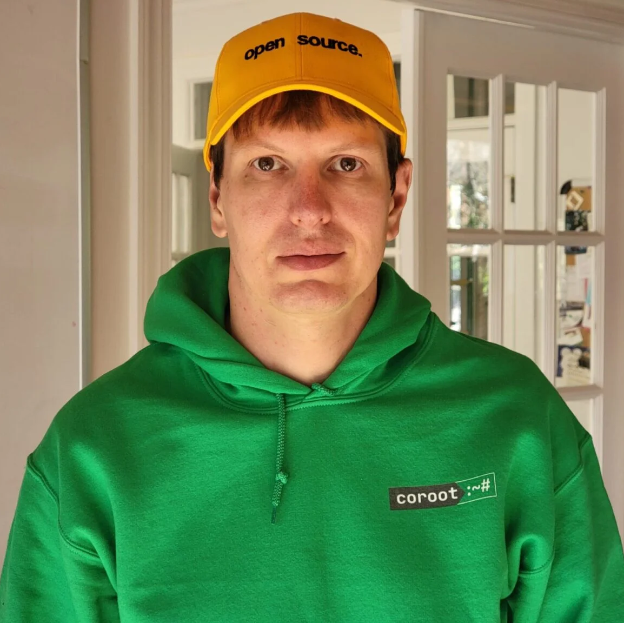
OPEN SOURCE
OBSERVABILITY
DAY 2025
Cloud-native Postgres observability: from client apps to underlying cloud resources
Peter Zaitsev,
Co-Founder at Coroot
October 23, 2025

Slide 2
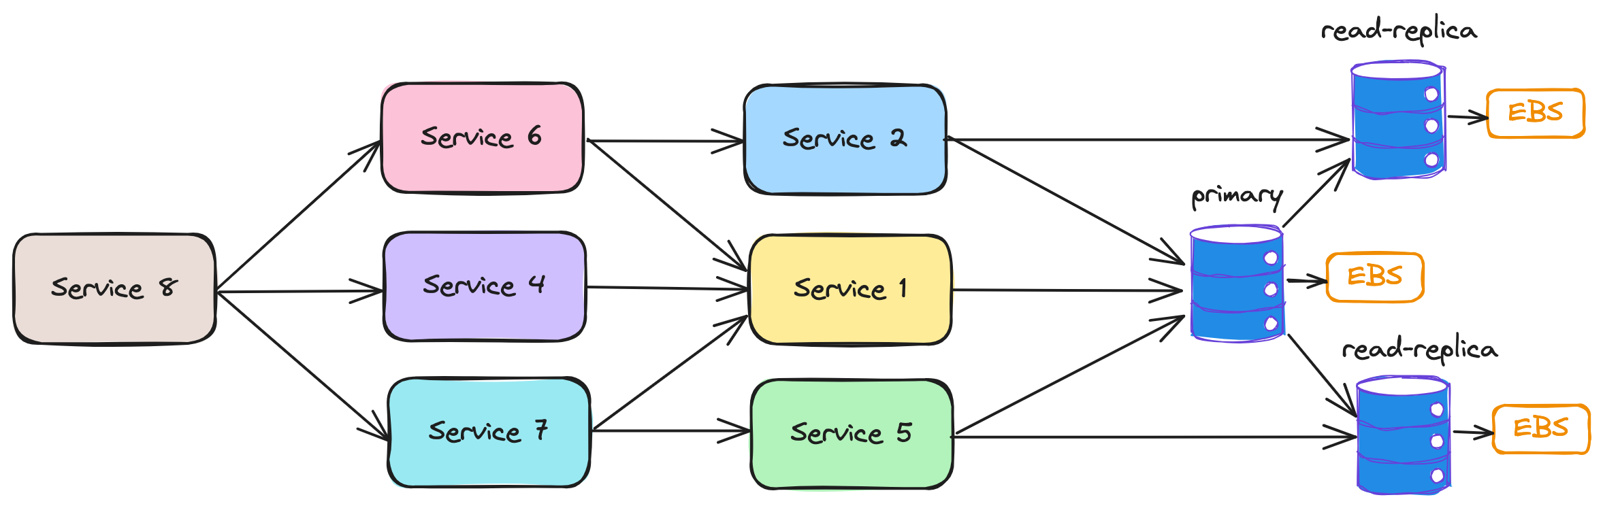
Modern systems
Hundreds or even thousands of services dynamically allocated to nodes
Nodes are dynamic and can appear and disappear
Network-attached volumes
If something goes wrong:
  Troubleshooting follows the system’s topology
  Analysis of extensive telemetry, from application latency to EBS performance

Slide 3
Modern Systems
Siloed Knowledge
Siloed Responsibility
Siloed Monitoring Systems
Finding out the problematic component can be harder than fixing the issue

Slide 4
Observability is …
… being able answer questions about your system:
How is the system performing right now?
How does its performance compare to an hour ago?
Why are some requests failing?
Why are certain requests taking longer than expected?
Observability is most valuable during system failures or issues, so we should think of it by considering failure scenarios
Notes:
One may argue you want to prevent problems before they happen… often this means by looking at micro-failures

Slide 5
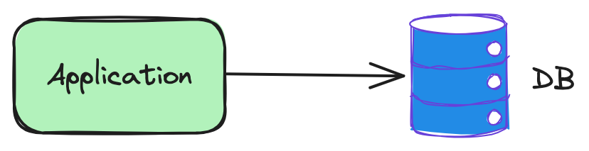
What can possibly go wrong here?
The app is not available
The DB is not available
Network connectivity issues between the app and the DB
Network delay between the app and the DB
The DB responses slowly
The DB rejects connections from the app
...

Slide 6
When we only look at the DB, we don't see the big picture
Error counters are not available in pg_stat_*
Per-client query statistics are not provided in pg_stat_*
Query latency in pg_stat_statements doesn’t include network latency

Slide 7
“The customer is always right”
Let’s consider databases as utility services
The Service Level metrics (availability, latency) should be measured on the client’s side
The database-side metrics are needed to “explain” the DB’s behavior, e.g., why the DB is rejecting connections or performing slowly.
Notes:
Analogies with power outages:
If a customer reports no power, it should be treated as a power outage, regardless of the operating status of the power plant.
During troubleshooting, engineers should analyze wires, power plant telemetry, and other relevant factors.

Slide 8
Client-side query statistics
What we want to know:
The number of queries from a given app instance to a particular DB instance
Errors (TCP level, L7-protocol level)
Latency
How we can gather these statistics:
Instrumenting apps with OpenTelemetry SDKs
Using eBPF to capture queries made by every process/container to measure the statistics
Notes:
Note the answer is BOTH – client side AND application side… but primary is app

Slide 9
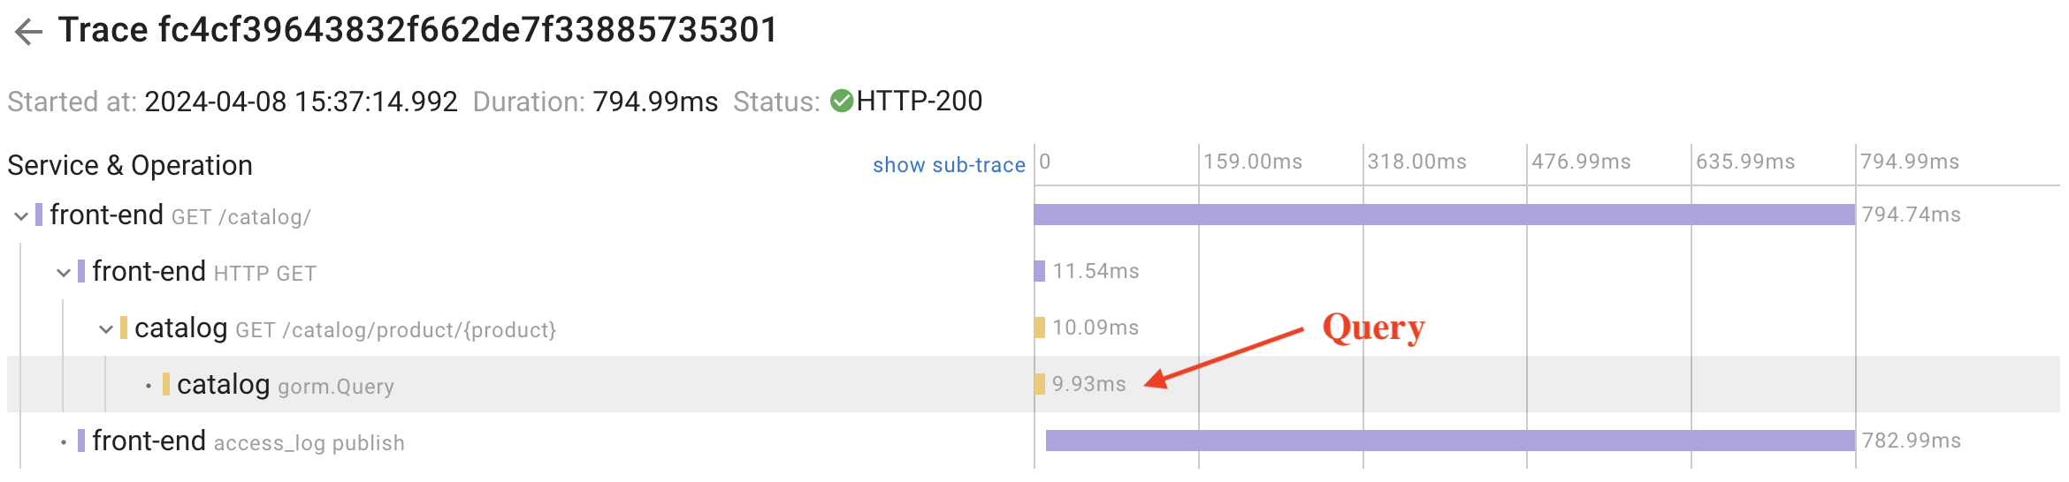
Instrumenting apps with OpenTelemetry
OpenTelemetry is a vendor-neutral framework for instrumentation applications, including database calls
SDKs are available for many programming languages and frameworks
It wraps every database call to gather statistics

Slide 10
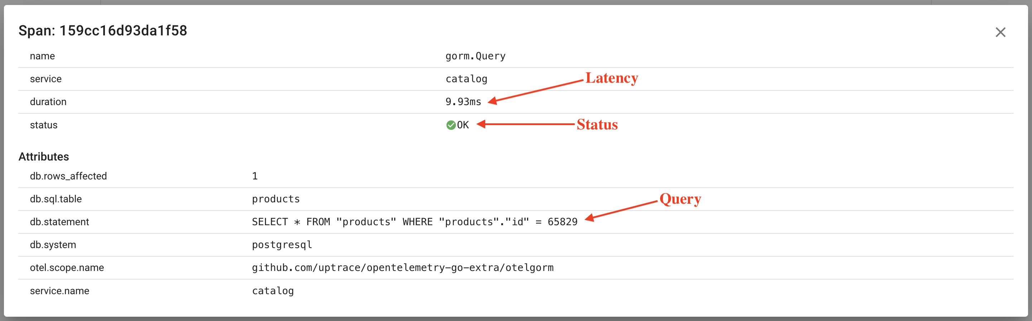
Instrumenting apps with OpenTelemetry
With distributed tracing we can know exactly what’s happened with any given request

Slide 11
Challenges associated with Distributed Tracing
Huge volume of telemetry data
Hard to achieve 100% coverage without blind spots (e.g., legacy services)
Requires code changes and application deployments
Potential overhead

Slide 12
eBPF-based instrumentation
An agent captures network calls from each process running on the node
It parses L7 protocols including Postgres Wire Protocol
Doesn’t require code changes, so can instrument even legacy and 3rd-party services
Can be integrated in minutes
Can capture stats even within SSL-enabled connections
Query latency contains network latency since it’s measured on client’s side
Doesn’t affect application latency*
Open-source implementations supporting Postgres: Coroot, Pixie, eCapture
* https://coroot.com/docs/coroot-community-edition/getting-started/performance-impact
Notes:
Performance impact benchmark:

Slide 13
eBPF-based instrumentation
Capturing System Calls:
connect(): obtaining PID, FD, destination IP:PORT, and status.
write(), writev(), sendmsg(), sendto(), SSL_write(), read(), readv(), recvmsg(), recvfrom(), SSL_read(): monitoring for Postgres protocol frames
Notes:
Performance impact benchmark:

Slide 14
eBPF-based instrumentation
Postgres Protocol Parsing:
Identifying Postgres protocol frames requires parsing only ~10 bytes of payload in kernel-space
Payloads (up to 1kB) are transferred to user-space along with (PID, FD, timestamp, payload)
Client app container is resolved using PID
Connection destination IP:PORT is resolved using PID + FD
If tracing is enabled, payload parsing extracts query text
For prepared statements, the agent maintains a mapping of statement_id to statement_text

Slide 15
eBPF: performance impact
The Linux kernel ensures minimal interruption to kernel code execution by validating each eBPF program before execution:
Program must have a finite complexity.
The verifier evaluates all possible execution paths within configured upper complexity limits
Communication between kernel-space and user-space programs occurs through a ring buffer:
If the user-space program delays data reading, it may miss data due to overwriting
For observability, it’s a great deal: although we might lose some telemetry data, we can be sure that there is no impact on performance

Slide 16
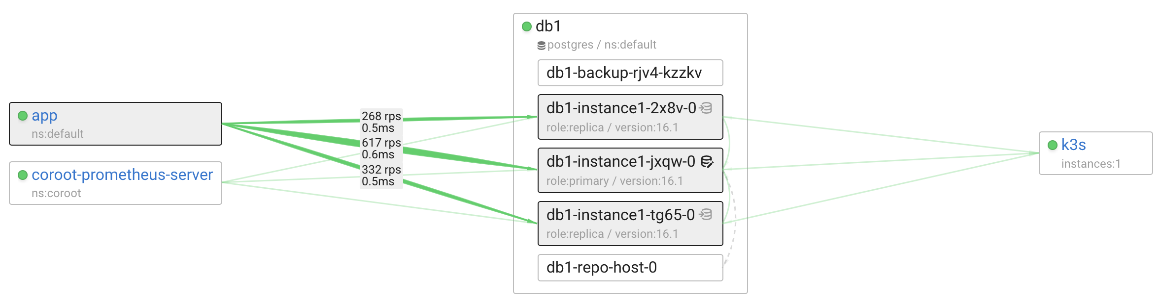
eBPF-based metrics
We know how each application instance communicates with each DB instance:
Queries per second
Errors
Latency

Slide 17
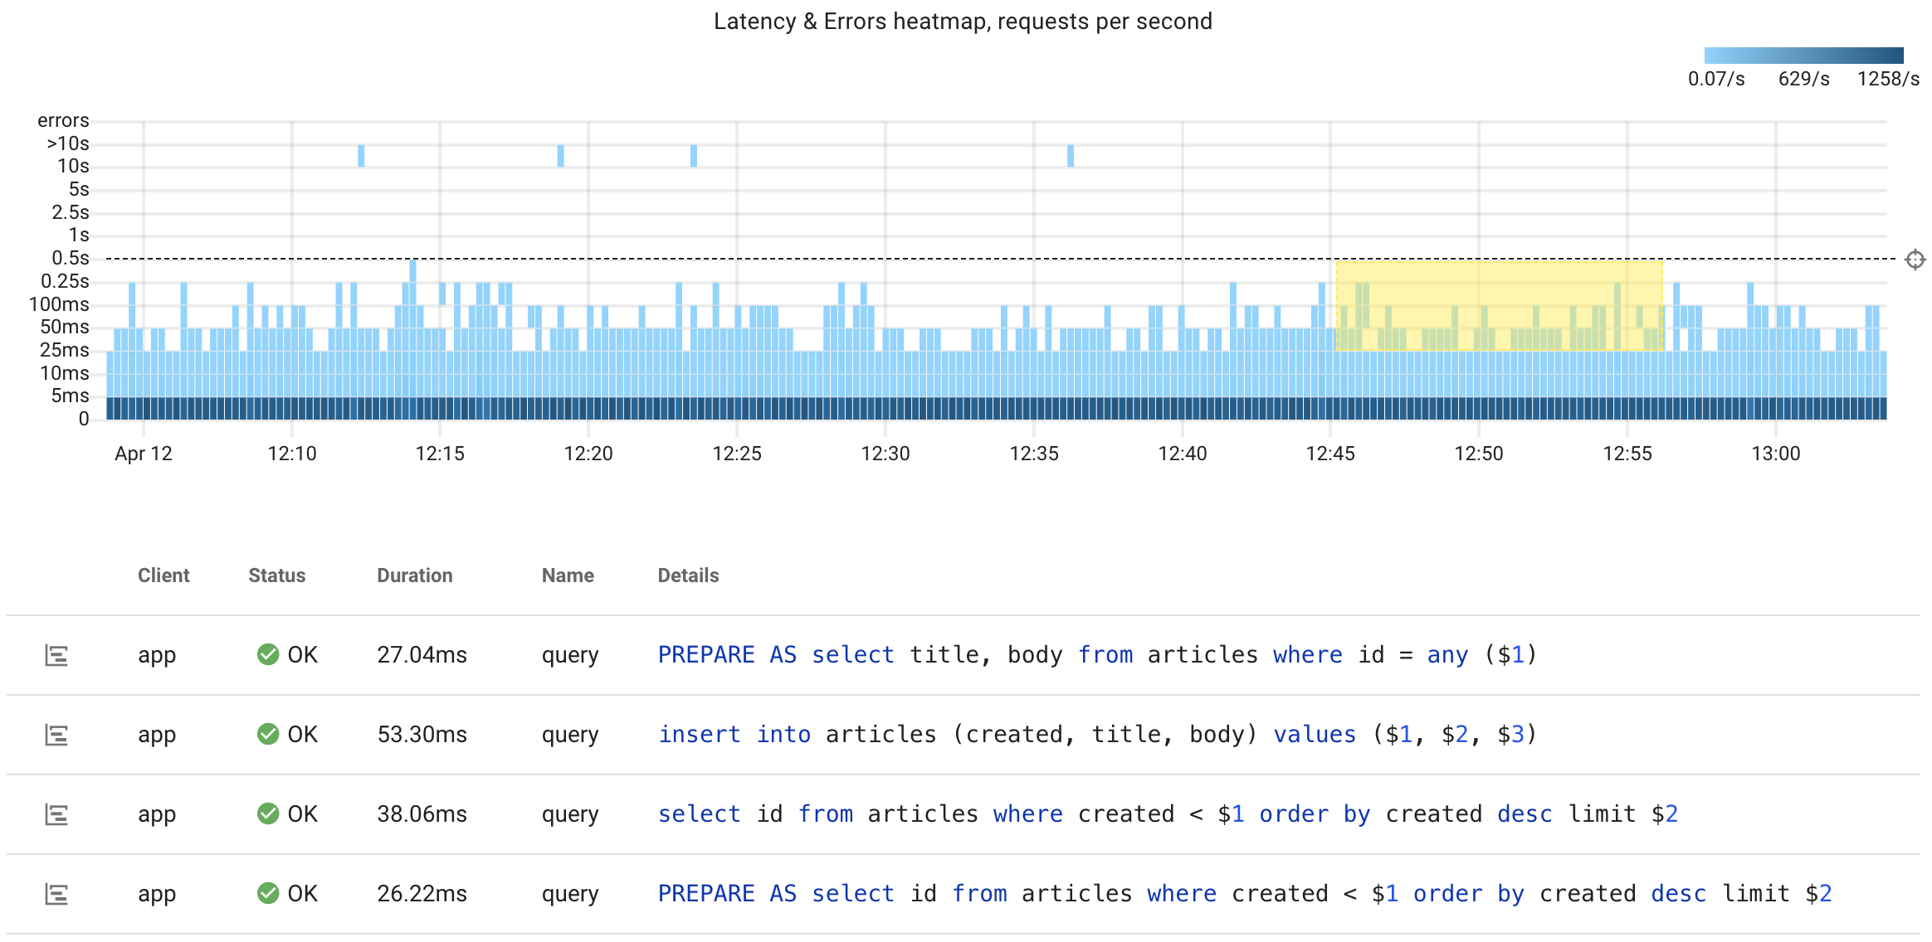
eBPF-based traces
Traces are extremely useful for identifying the particular queries within an anomaly
They also provide a more granular distribution of queries by latency and status

Slide 18
Postgres metrics
eBPF-based metrics and traces can’t answer all questions:
Why is the database performing slower than before?
Why is the database rejecting new client connections?
While eBPF-based metrics can highlight what is happening, to answer WHY it’s happening, we need to collect other metrics.

Slide 19
Why are my queries executed slower that usual?
A lack of CPU time
  Node CPU capacity
  Resource limits leading to CPU throttling
  Resource contention caused by other applications
  Resource contention caused by other queries
Issues related to I/O performance
  Volume I/O capacity (Block storage I/O limits, hardware performance)
  High I/O latency, particularly with network-attached volumes
  Resource contention due to other applications
  Resource contention due to other queries
  Using temp files due to insufficient work_mem
Locks

Slide 20
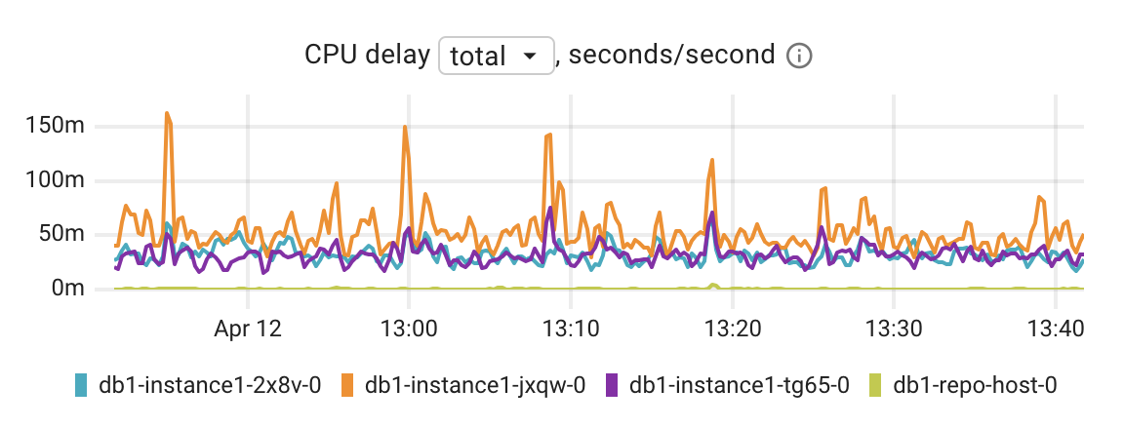
CPU related metrics: CPU delay
The Linux kernel reports CPU delay, indicating how long a specific process or container has been waiting for CPU time
For instance, if you observe a delay of 150ms per second, it signifies that you are experiencing an additional latency of 150ms, which is spread across all queries processed during that wall-clock second
Next steps: check CPU throttling, node CPU usage, other CPU consumers

Slide 21
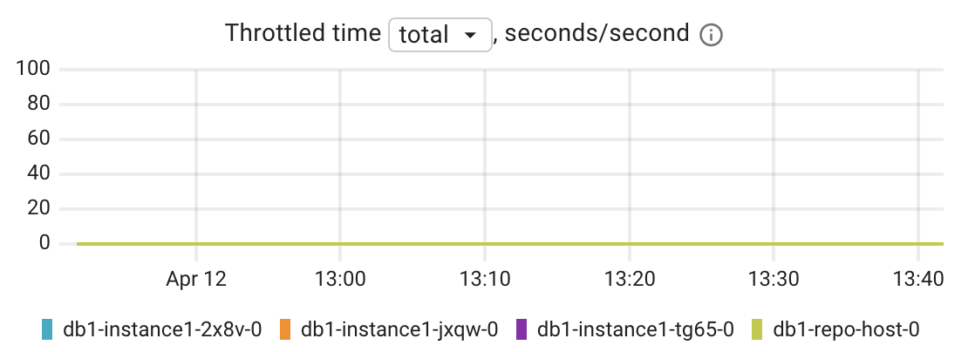
CPU related metrics: CPU throttling
When a container hits its CPU limit and exhausts the allowed CPU bandwidth, it gets throttled for the remainder of that period.
This introduces additional latency spread across all queries processed during that wall-clock second.
If a container is CPU-limited (throttled), the CPU delay metric will also increase

Slide 22
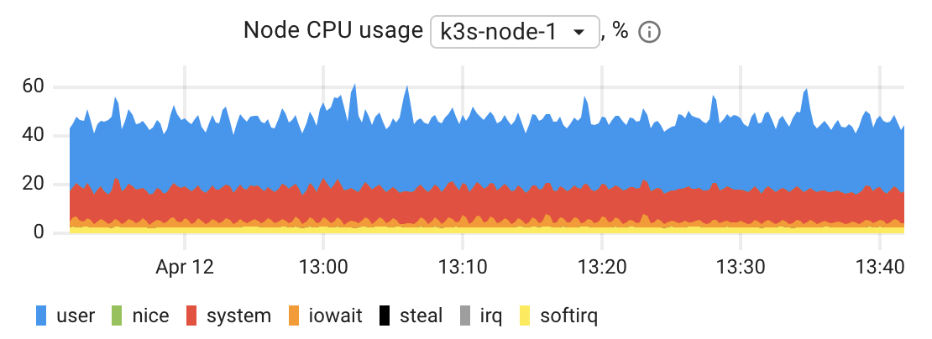
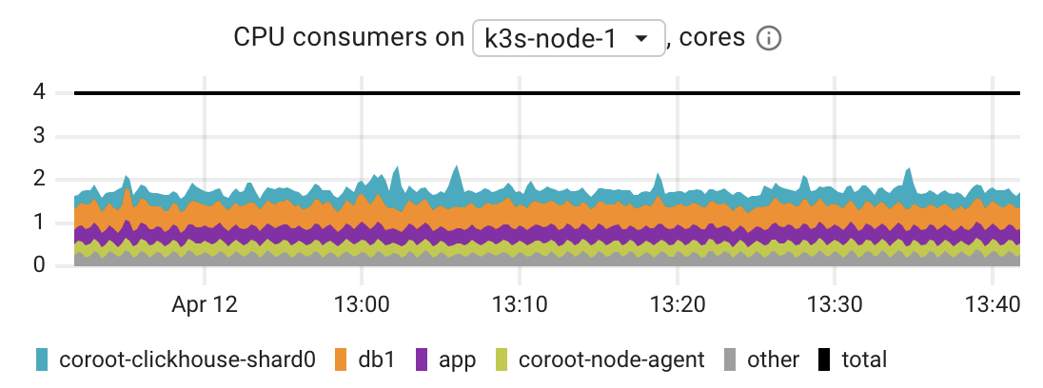
CPU related metrics: CPU usage
Node CPU capacity always is limited
Processes on the same node compete for CPU time
In dynamic environments like Kubernetes, it's useful to track CPU usage per application running on a node to explain any CPU usage anomalies

Slide 23
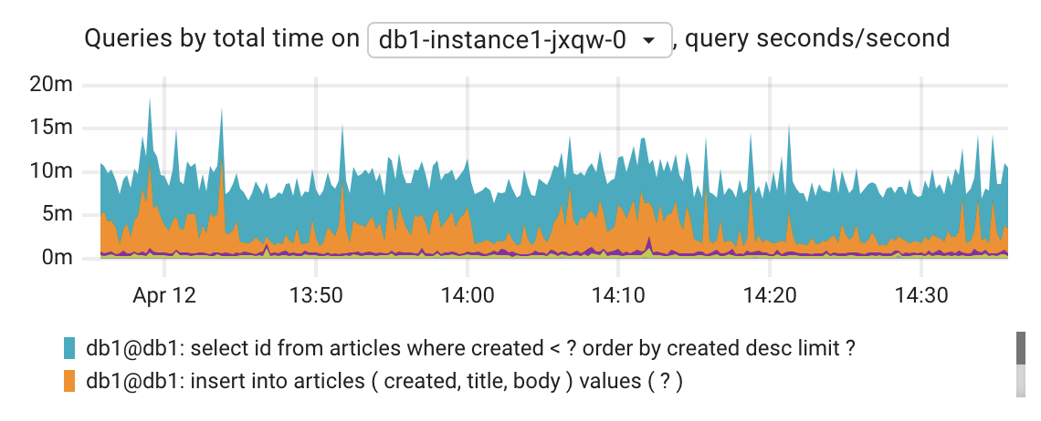
CPU related metrics: CPU usage by queries
Postgres doesn’t count CPU usage by queries
To roughly estimate that we can use total query execution time
pg_stat_statements provides statistics only for finished queries
To get visibility into long-running queries that are not finished yet, we need to merge statistics from pg_stat_statements and pg_stat_activity

Slide 24
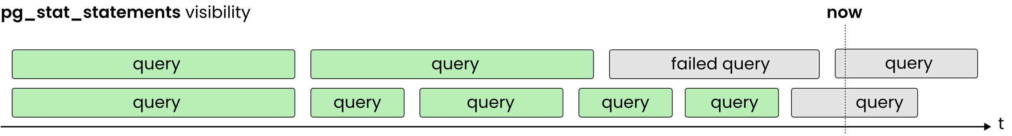
pg_stat_statement visibility
Only displays finished queries
Queries that finish with errors/timeout are not taken into account

Slide 25
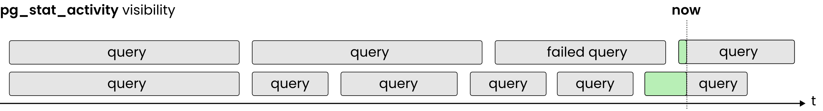
pg_stat_activity visibility
Doesn’t track history
Hard to track short-lived queries

Slide 26
pg_stat_statements + pg_stat_activity
To achieve full query visibility, we implemented an open-source (Apache 2.0) Prometheus metric exporter for Postgres
It aggregates data from pg_stat_statements and pg_stat_activity to provide accurate metrics about queries, whether they are completed or still running
Fully integrated with Coroot (Apache 2.0)
https://github.com/coroot/coroot-pg-agent
https://github.com/coroot/coroot

Slide 27
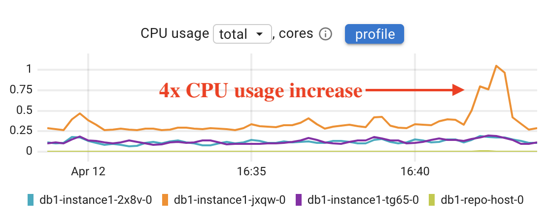
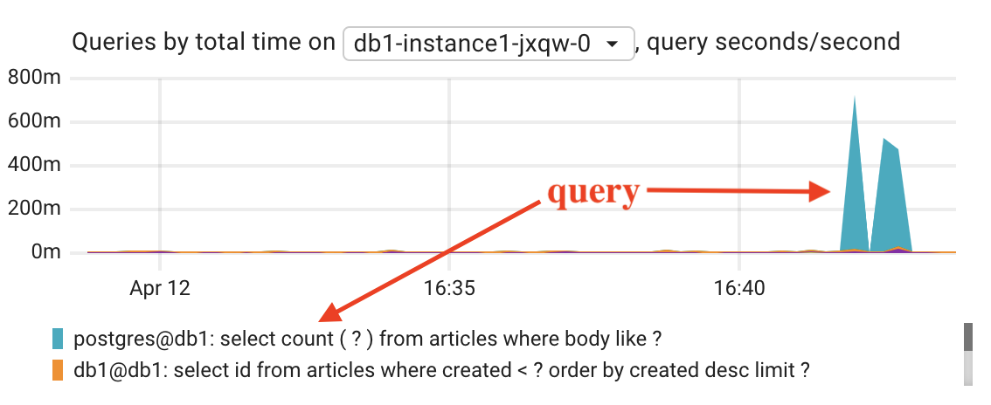
Explaining a CPU anomaly

Slide 28
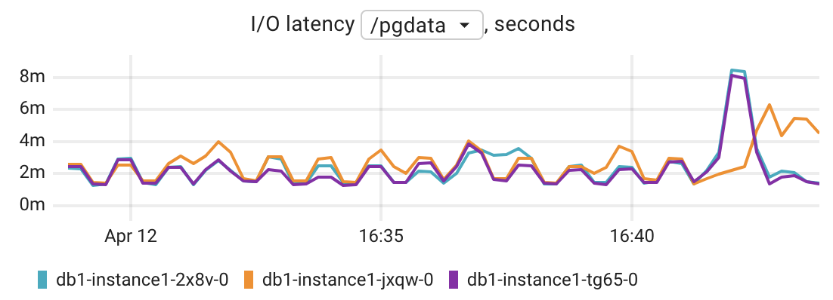
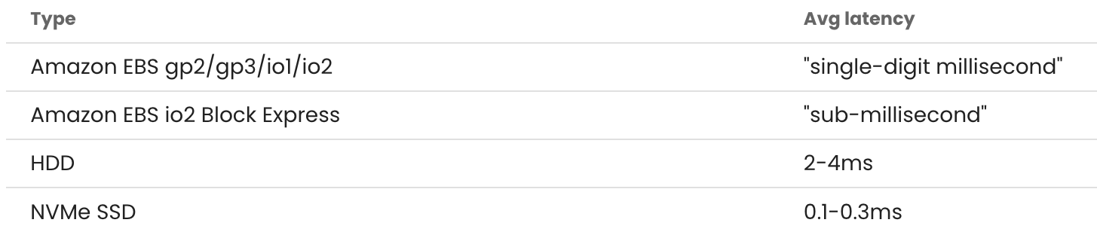
I/O related metrics: I/O latency
An average time spent doing read and write operations

Slide 29
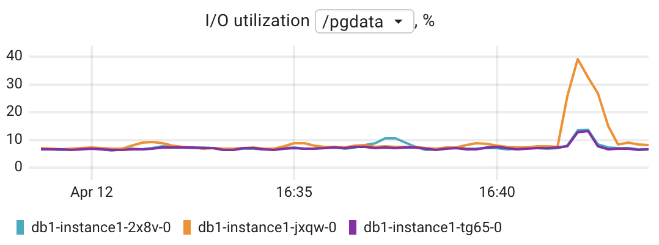
I/O related metrics: I/O utilization %
Total number of seconds the disk spent doing I/O
E.g., if the derivative of this metric for a minute interval is 60s, this means that the disk was busy 100% of that interval.

Slide 30
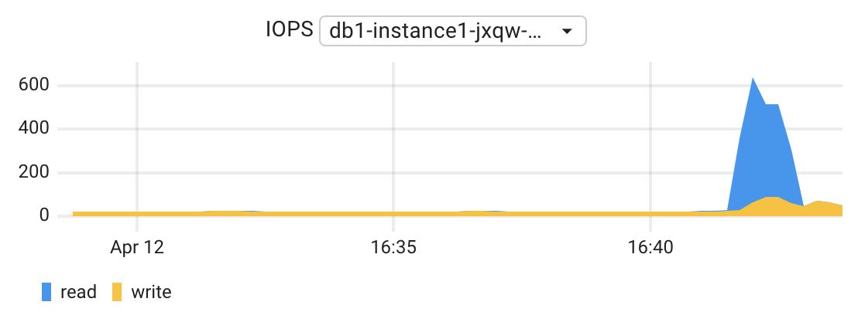
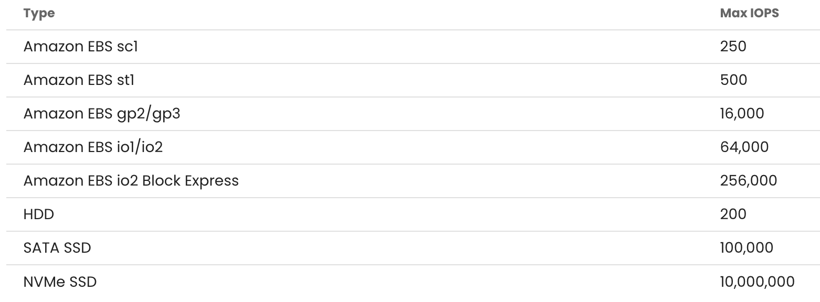
I/O related metrics: IOPS
Total number of reads or writes completed successfully.

Slide 31
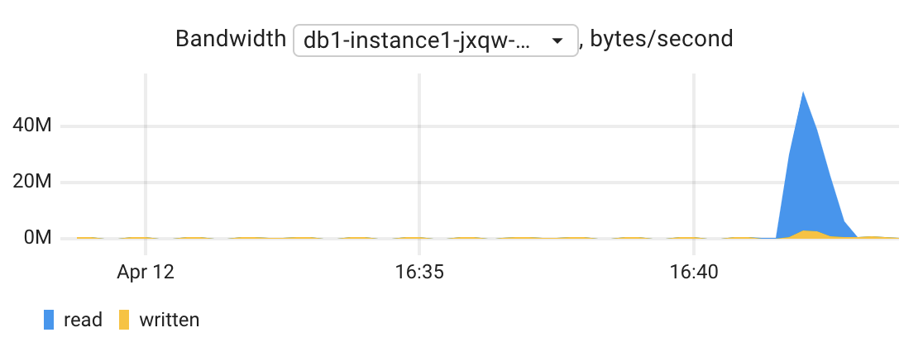
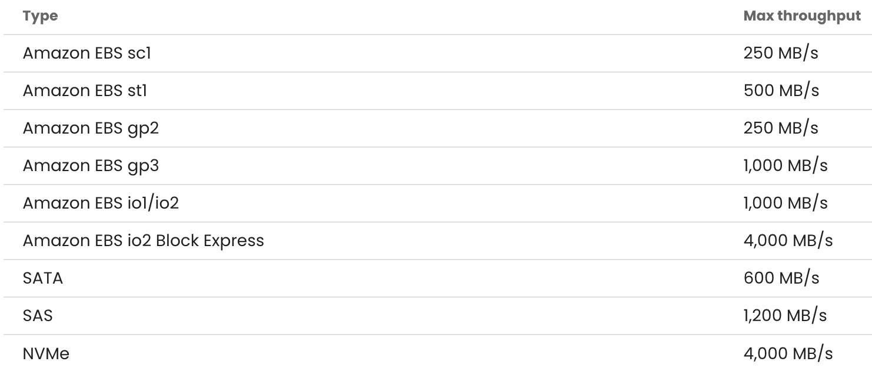
I/O related metrics: I/O bandwidth
Total number of bytes read from the disk or written to the disk

Slide 32
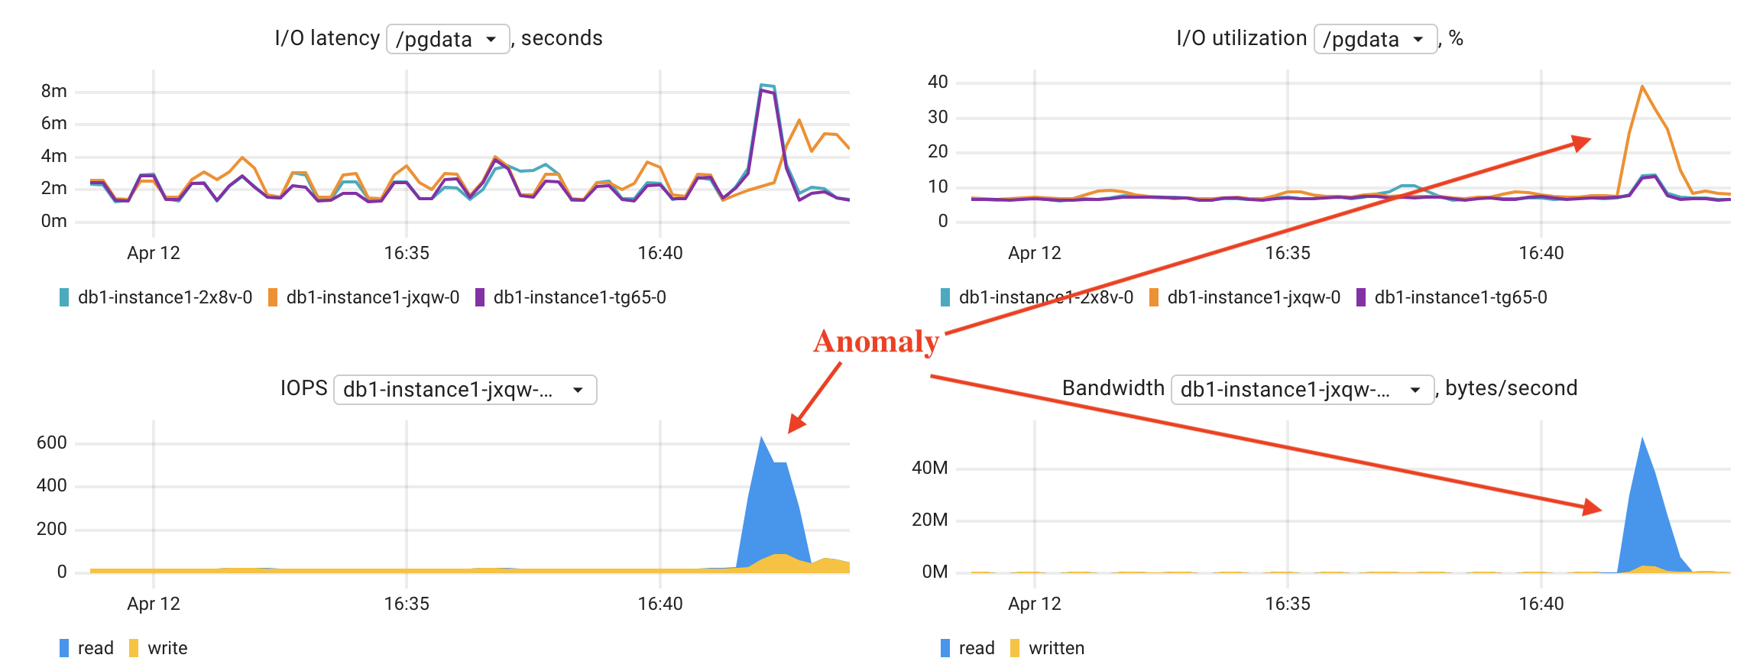
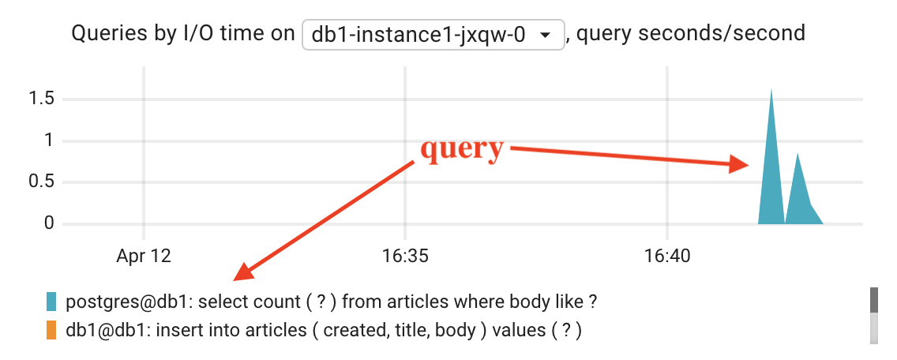
Explaining an I/O anomaly

Slide 33

How to be able to solve the issue ?
Ensure your observability is complete, with no blind spots
Ensure you have tools to reliably identify the components experiencing issues
Use skill-appropriate tools, less can be more in the time crunch
Have evidence for escalation to another team or vendor

Slide 34

Thank you, Let’s Connect!
https://www.linkedin.com/in/peterzaitsev/
https://twitter.com/PeterZaitsev
http://www.peterzaitsev.com

